Slide 1
React JS DOM

Slide 2
Real/Browser DOM:
DOM stands for 'Document Object Model'. It is a structured representation of HTML in the webpage or application. It represents the entire UI(User Interface) of the web application as the tree data structure.
It is a structural representation of HTML elements of a web application in simple words.
Whenever there is any change in the state of the application UI, DOM is updated and represents the change. The DOM is rendered and manipulated with every change for updating the application User Interface, which affects the performance and slows it down.

Slide 3
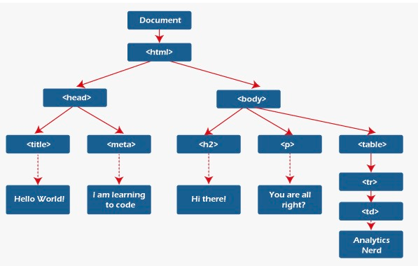

Slide 4
Updating the DOM:
If we know some about JavaScript you may see people using the 'getElementById()' or 'getElementByClass()' method to modify the contents of DOM.
Whenever there is any change that occurs in the state of your application, the DOM is updated to reflect the change in the UI.

Slide 5
How Virtual DOM speeds things up:
When any new things are added to the application, the virtual DOM is created, represented as a tree. Every element in the application is a node in the tree.
Therefore, whenever there is a change in the position of an element, a new virtual DOM is created. The newer virtual DOM tree is compared with the latest, where the changes are noted.
It finds the possible way to make these changes by the actual DOM. Then the updated elements would re-render on the page.

Slide 6
Although it may seem ineffective, the cost is no more, as updating the virtual DOM cannot take much time.
When comparing the current virtual DOM tree with the previous one is known as 'defying'. Once React knows what has changed, it updates the objects in the actual DOM. React uses batch updates to update the actual DOM. It changes to the actual DOM are sent in batches rather than sending any updates for the single change into the component's state.
Re-rendering the UI is the most expensive part, and React manages to do most efficiently by ensuring the Real DOM that receives the batch updates to re-render the UI. The process of converting the changes to the actual DOM is called reconciliation.
It improves performance and is the main reason developers love react and its Virtual DOM.

Slide 7
Each UI is an individual component, and every component has its state.
React follows observable patterns and observes the changes in states.
Whenever any change is made to the component's state, React updates the virtual DOM tree but does not change the actual DOM tree.
React compares the current version of the virtual DOM with the previous version after updating.
React knows which objects are changed in the virtual DOM. It replaces the objects in the actual DOM, leading to minimal manipulation operations.

